Slide 1

No Cost, No Worries: Burden Free Materials
Prof. Lisa Burgert & Prof. Marley Rodriguez

Slide 2
Title 5,§ 54221. Burden-Free Access to Instructional Materials.
Ensure students have access to required textbooks and materials on Day 1
Emphasis is on Open Educational Resources (OER)
July 30, 2025 went into effect
bit.ly/CA54221

Slide 3
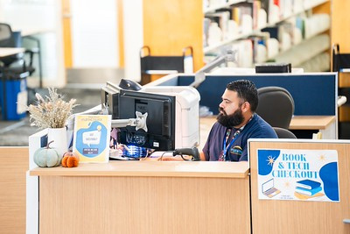
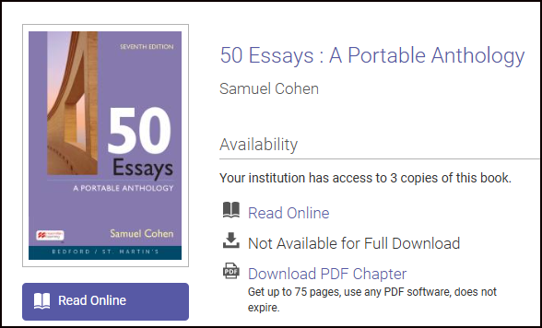
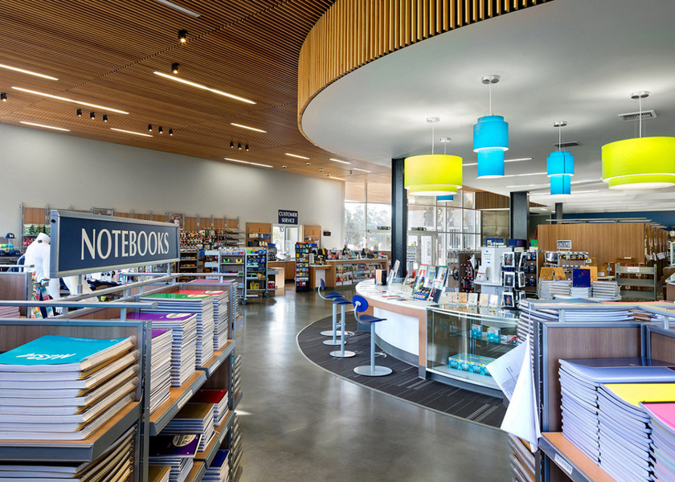

Solutions

Slide 4
SDCCD Libraries
Course Reserves
Print textbooks check out to students for 4 hours a time.
Students can scan the chapters needed.

Slide 5
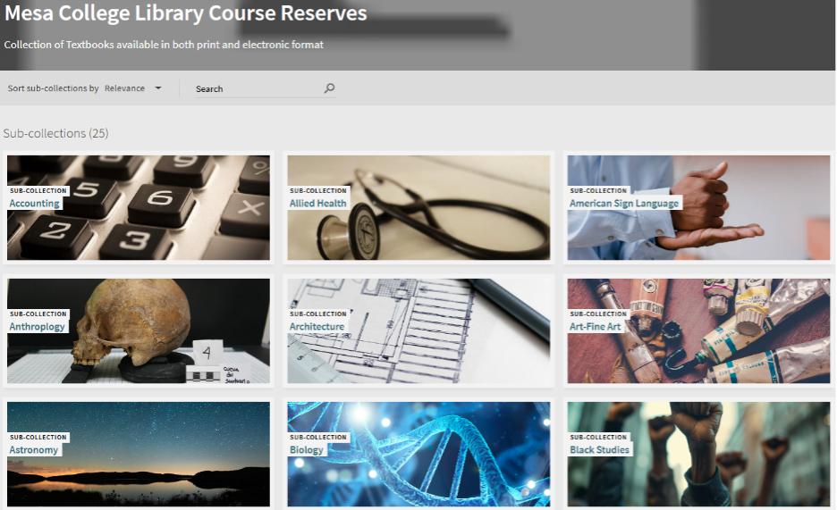
SDCCD Libraries
Digital Course Reserves
Alma-D
Digital Access 24/7.
Students log in and have access.
*Typically only 1 copy available at a time

Slide 6
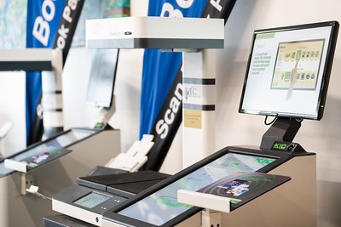
SDCCD Libraries
Digital Scanning
*Up to 20% of a work per SDCCD Copyright Guidelines

Slide 7
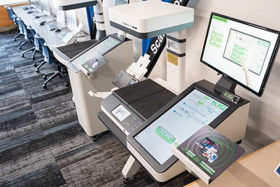
SDCCD Copyright Guidelines
Teach Act
Fair Use

Slide 8




SDCCD Libraries
E-books
Databases
Videos

Slide 9
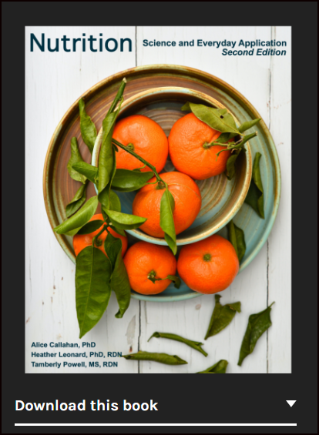
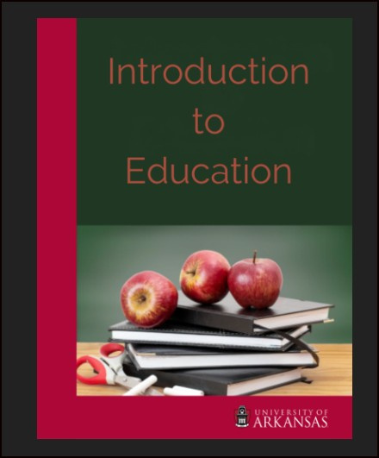
ASCCC OERI
OER by Discipline/C-ID
New OER
Canvas Commons
Webinars FLEX Credit 30457 Colleges
ASCCC-OERI.org

Slide 10

ZTC Grant Funding
Specific degree pathways have funding.
Contact
Mesa: Kyle McLearyKmccleary@sdccd.edu
City: Melanie Nakaji
mnakaji@sdccd.edu

Slide 11
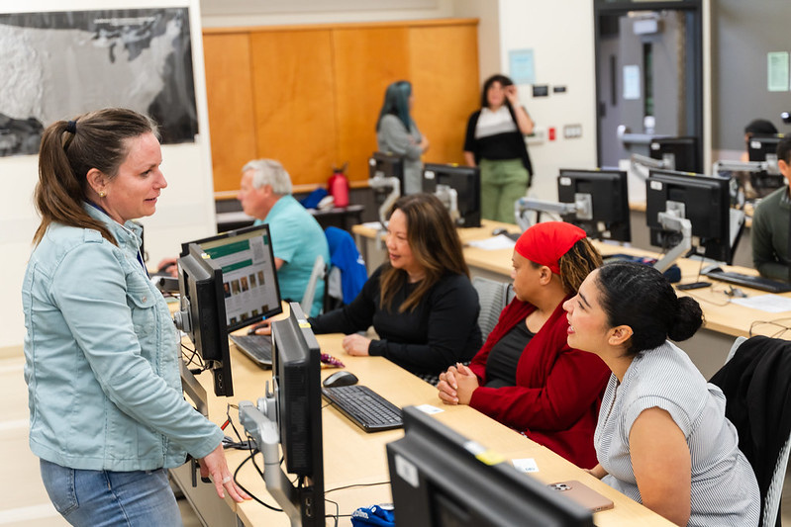
We are here to support you
Bookstore
Library
SDCCD Online Learning
ASCCC OERI
ZTC Grant Funding

Slide 12
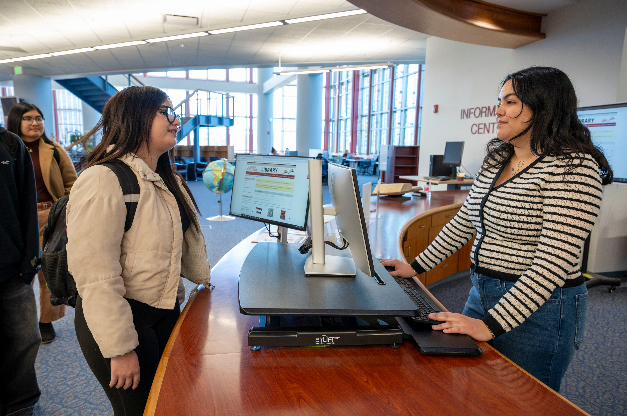
Questions?
Lisa Burgert, Mesa Librarian LBurgert@sdccd.edu
Marley Rodriguez, City Librarian
mrodriguez@sdccd.edu
Angela Boyd, Miramar Librarian
aboyd001@sdccd.edu

